Slide 1

Modeling Lithium Extraction from Produced Water with ePC-SAFT
HBTA/TOPO solvent-extraction case study for chemical engineers
Updated technical deck: source-backed Smackover feed, Li/Na stage-transfer model, PrOMMiS/IDAES process interface, and upstream ePC-SAFT solver needs.
2026-05-07
Lithium Extraction with ePC-SAFT
1

Slide 2
1. Technical Thesis
Produced-water lithium extraction needs a thermodynamic model that maps basin chemistry into solvent-extraction transfer variables. The benchmark chemistry is non-ionic HBTA/TOPO/sulfonated kerosene; ePC-SAFT is evaluated as the equilibrium backbone for PrOMMiS and IDAES.
Feed basis: southern Arkansas Smackover brine.
Solvent chemistry: HBTA/TOPO complexation with selective Li transfer.
Thermodynamic target: electrolyte liquid-liquid equilibrium and ion-specific distribution.
Process target: staged extraction, surrogate generation, and IDAES costing.
Lithium Extraction with ePC-SAFT
2

Slide 3
2. Basin Thermodynamic Basis
Produced-water brines are not one feed.
Basin | Li signal | TDS signal | Engineering implication
Appalachian | 127-205 mg/L subsets | often >100,000 mg/L | high Li but variable
Permian | Wolfcamp near 14 ppm | <25-140 g/L | high water volume, lower grade
Williston | >100 mg/L possible | ~308 g/L | salinity dominates pretreatment
Smackover | ~1-477 mg/L | 156,000-340,000 mg/L | premium but hard case
The Smackover case is valuable because it is thermodynamically unforgiving: high Li, high TDS, major competing ions, and real brine infrastructure.
Lithium Extraction with ePC-SAFT
3

Slide 4
3. Selected Smackover Feed Basis
Variable | Base value | Why it matters
Source row | MS-2 / MSPU 4-W1 | source-backed observed brine
Li | 168 mg/L | value and recovery basis
TDS | 305,000 mg/L | ionic-strength regime
Na / Ca / Mg | 64,100 / 36,900 / 3,310 mg/L | selectivity and pretreatment burden
Cl / Br | 174,000 / 2,700 mg/L | hypersaline chloride matrix
Feed and chemistry are deliberately separated: the feed is Smackover; the extraction chemistry is Shan/Gando HBTA/TOPO. This avoids claiming a measured Arkansas HBTA/TOPO experiment.
Lithium Extraction with ePC-SAFT
4

Slide 5
4. Why ePC-SAFT Is Needed
Fixed transfer placeholders can
They cannot defend
reproduce a narrow point
run quickly in a flowsheet
debug material balances
basin-to-basin extrapolation
hypersaline electrolyte behavior
solvent and O/A sensitivity
ion-specific distribution
The process model needs a physical equilibrium layer before surrogate fitting or optimization is meaningful.
Lithium Extraction with ePC-SAFT
5

Slide 6
5. ePC-SAFT Output Required By Process Models
Process need | Thermodynamic output | Use in PrOMMiS / IDAES
Feed state | zi, TDS, temperature, ion basis | basin-specific inlet
Phase split | aqueous/organic compositions, phase fraction | stage equilibrium target
Transfer strength | Di = Corg / Caq | material-balance transfer term
Selectivity | SLi/Na, later SLi/Mg and SLi/Ca | solvent screening and constraints
Validity | residuals, phase flags, domain bounds | surrogate trust-region filter
Percent extraction is useful for presentation; staged unit models need phase compositions, distribution ratios, selectivity, and validity diagnostics.
Lithium Extraction with ePC-SAFT
6

Slide 7
6. Solvent Set Chosen For The Case Study
Priority | System | Role | Current status
1 | HBTA + TOPO + sulfonated kerosene | flagship | field-water evidence; Li/Na model is source-regressed
2 | D2EHDTPA + BuPhen + octanol | backup | strong multication selectivity; missing parameter set
3 | TBAC + decanoic-acid DES + TOPO | regression pilot | PC-SAFT/ePC-SAFT smoke test; different chemistry
4 | TBP + FeCl3/HCl | mechanistic comparator | high-Mg relevance; harder process burden
HBTA/TOPO carries the non-ionic case; the backups define the data needed to broaden the predictive envelope.
Lithium Extraction with ePC-SAFT
7

Slide 8
7. HBTA/TOPO Li/Na Stage Model
One-stage MS-2 result
Model boundary
Li extraction: 47.2846%
Na extraction: 0.0131%
DLi = 0.8970
SLi/Na = 6840.1
Raffinate Li: 88.56 mg/L
2 HBTA : 1 TOPO : 1 Li stoichiometry
aqueous Li/Na activity correction from ePC-SAFT when available
source-regressed Li/Na transfer, not full multication reactive LLE
The missing organic HBTA/TOPO/diluent/complex parameters remain the main thermodynamic closure gap.
Lithium Extraction with ePC-SAFT
8

Slide 9
8. Li/Na Regression Closure
Anchor | Source | Target | Prediction | Residual
Stage 1 Li cumulative | Gando/Shan 2025 | 54.95% | 54.8882% | -0.0618 pp
Stage 2 Li cumulative | Gando/Shan 2025 | 85.60% | 85.7224% | +0.1224 pp
Stage 3 Li cumulative | Gando/Shan 2025 | 97.17% | 97.0385% | -0.1315 pp
Li/Na selectivity lower bound | Zhang 2017 | 2100 | 2100.008 | +0.008
This is predictive only in the Li/Na staged-transfer sense: one shared parameter payload is reused across feed cases. Mg, Ca, Sr, Ba, diluent, and complex parameters remain explicit limits.
Lithium Extraction with ePC-SAFT
9

Slide 10
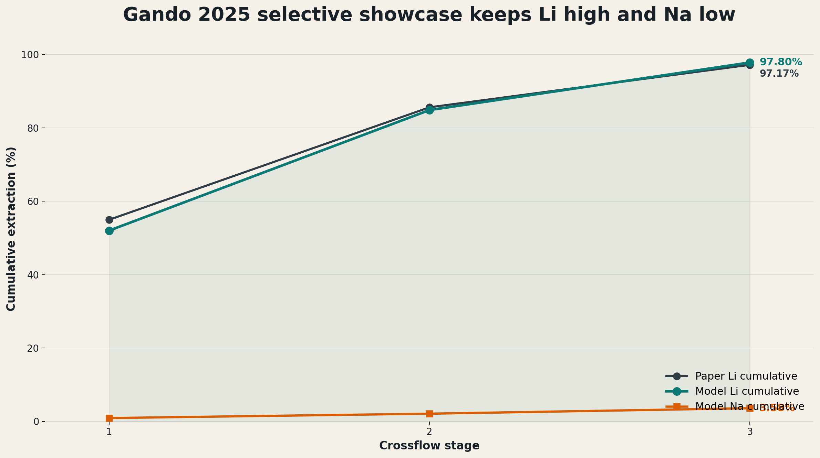
9. Multi-Stage Selective Extraction
Three-stage chain
Stage 1 Li: 47.28%
Stage 2 Li: 89.58%
Stage 3 Li: near-total signal
Stage 3 Na: 0.116%
Costing cap: 97.17%
Near-total extrapolated transfer is a design signal, not a final physical claim. Costing uses the source-backed 97.17% three-stage anchor.
Lithium Extraction with ePC-SAFT
10

Slide 11
10. PrOMMiS / IDAES Integration Path
Step | Implementation path | Engineering reason
1 | offline ePC-SAFT data generation | lowest-risk source model
2 | bounded surrogate layer | fast flowsheet optimization inside trust region
3 | external function option | high-fidelity calls where justified
4 | PrOMMiS/IDAES unit model | staged extraction, recycle, stripping, costing
The preferred first integration is not direct coupling everywhere; it is a traceable thermodynamic data generator feeding bounded process models.
Lithium Extraction with ePC-SAFT
11

Slide 12
11. Formal IDAES Costing Scaffold
Block | Current basis | Needed before TEA
Feed basis | Smackover base feed; 100/1000/10000 m3/day | flowrate and uptime
Pretreatment | Pyomo scenario expression | removal target and reagent use
Extraction/contacting | three-stage HBTA/TOPO stage solve | contactor sizing and solvent inventory
Solvent loss | low/base/high placeholder | HBTA/TOPO/diluent prices and loss rate
Li2CO3 product | 99.28% purity; 97.17% recovery cap | energy, carbonate reagent, product spec
The current economics are a formal IDAES/Pyomo scaffold, not a vendor-grade TEA.
Lithium Extraction with ePC-SAFT
12

Slide 13
12. Remaining Engineering Work
Priority | Work item | Reason
1 | extract Zhang 2017 distribution, O/A, temperature, capacity data | improves Li/Na transfer identifiability
2 | regress HBTA, TOPO, diluent, Li-complex parameters | moves toward reactive ePC-SAFT closure
3 | build PrOMMiS MSContactor validation case | tests staged convergence and mass balances
4 | replace Class-5 costing assumptions with engineering ranges | improves economic credibility
The present model is strong enough for a Li/Na process-interface case study; it is not yet a full multication reactive LLE model.
Lithium Extraction with ePC-SAFT
13

Slide 14
13. Upstream ePC-SAFT Solver Needs
Observed timeout pattern
Package improvement targets
Hubach bounded single-point and Jang limitation scripts exceed a 180 s wall-clock cap.
Prior Hubach diagnostics show one-phase-collapse acceptance failure, not a missing public API.
Jang reaches difficult density/LLE regions for a high-component placeholder system.
strict time and iteration budgets in public equilibrium calls
continuation and seed reuse as first-class options
early bailout for collapsed candidates and repeated density failures
structured diagnostics for surrogate trust regions
Lithium Extraction with ePC-SAFT
14

Slide 15
14. Takeaway
The case study has moved from a fixed extraction placeholder to a source-regressed Li/Na thermodynamic-process interface. The next step is to harden ePC-SAFT electrolyte LLE so the same workflow can support high-rigor multication and organic-phase closure.
HBTA/TOPO remains the flagship non-ionic solvent set.
Smackover is the stress-test brine, not an overclaimed measured extraction case.
PrOMMiS/IDAES integration is framed around transferable variables: D, selectivity, phase split, and validity.
Lithium Extraction with ePC-SAFT
15

